Slide 1

MAHATMA GANDHI NATIONAL RURAL EMPLOYMENT THOZHILURAPPU PADHATHI
Aneesha Martin
FIT20MCA-2022

Slide 2
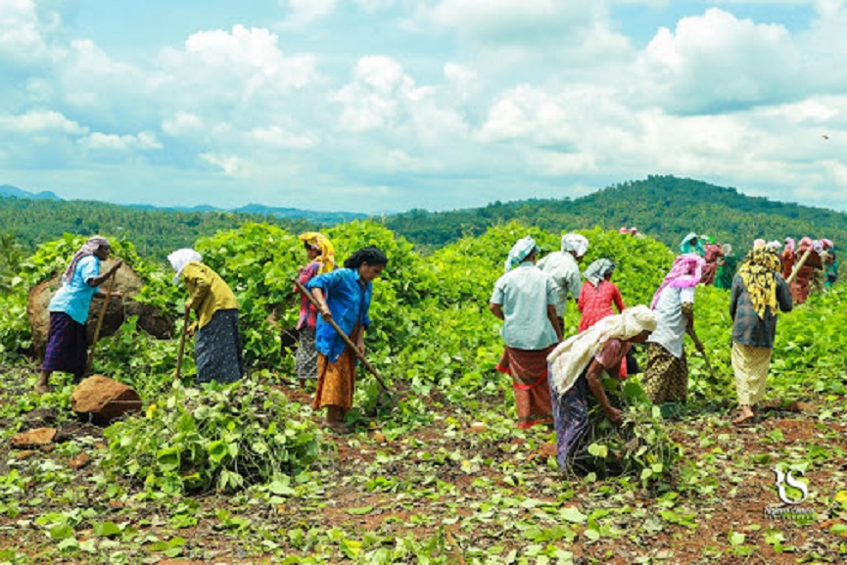
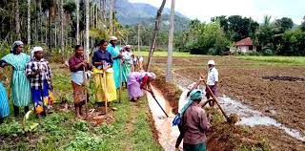
Relevance of the topic
This project is very useful for the people. This system is very safe and secure than the old system. It saves money of the people as they do not need to travel to know many things about their job card, attendance, salary etc

Slide 3
DESCRIPTION
Mobile Phone Acts As A Mode Of Communication With People At Farther Places, With Greater Ease And Lesser Time .This application can be used by the authorized personnel and the general public to get and give updates about the status of various works that has been implemented under the Mahatma Gandhi National Rural Employment Gurantee Act. This app is also used by the authorized personnel of the Rural Development..

Slide 4
EXISTING AND PROPOSED SYSTEM
Existing system - doesn’t have an app for Manjapra panchayath.
In method all information is stored in books that is book keeping method is followed and this is not safe enough
In existing system data is not secure

Slide 5
PROPOSED SYSTEM
In proposed system there no need of books.
It is secure
It is not that much expensive

Slide 6
ADVANTAGE
Secure
It is easy to use

Slide 7
WHO CAN USE THIS ?
Administration:
It makes sure that there is no malpractice in the process of registration, distribution of job cards, etc. and also maintains all related registers at the Gram Panchayat level. all the technical sanctions are issued, recorded and monitored by them.
Mates:
This department is responsible for supervising worksites regularly. They also capture daily attendance , maintain measurement books at the work sites and update entries in the job card.

Slide 8
Labours:
They are the workers of this scheme. They can know about their registrations and the hours of works they have done. They can view their job card.
Users:
If we need someone to clean our surroundings, we can initiate it. We can choose how many persons we want.

Slide 9
MODULES
Registration
Attendance
Payment
Job Management

Slide 10
1.REGISTRATION • The first module is registration the user and labours can register into the application
2.ATTENDANCE • Mates can mark the attendance of labours can view their attendance

Slide 11
PAYMENT • Admin can update the salary of labours and labour can view their salary 4.JOB MANAGEMENT • If we need someone to clean surrounding we can initiate we want. Mates can also use. The registered users can also use this module

Slide 12
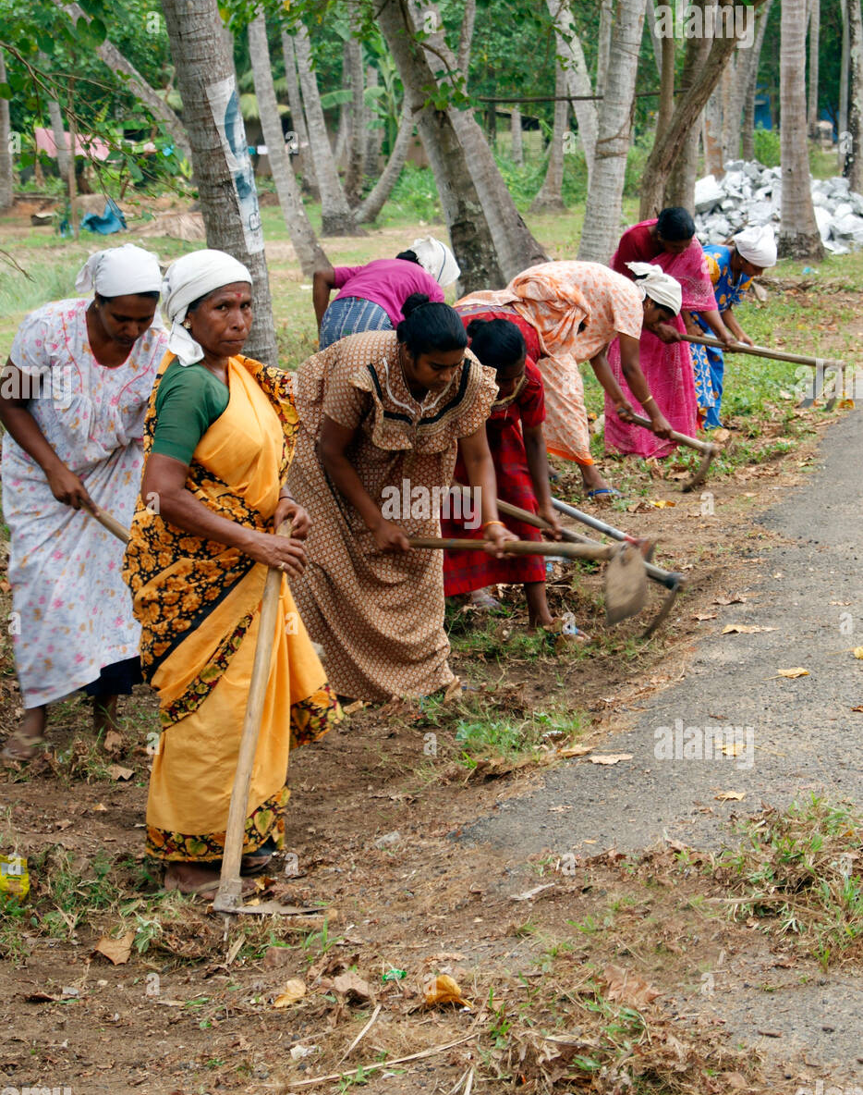
SCREENSHOT

Slide 13
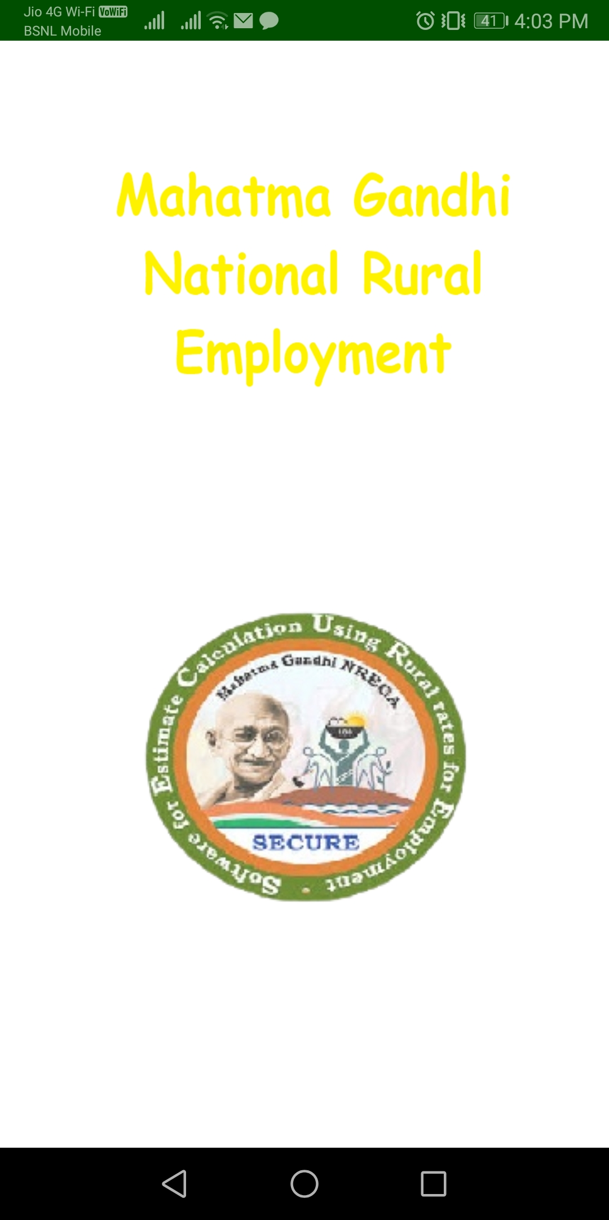
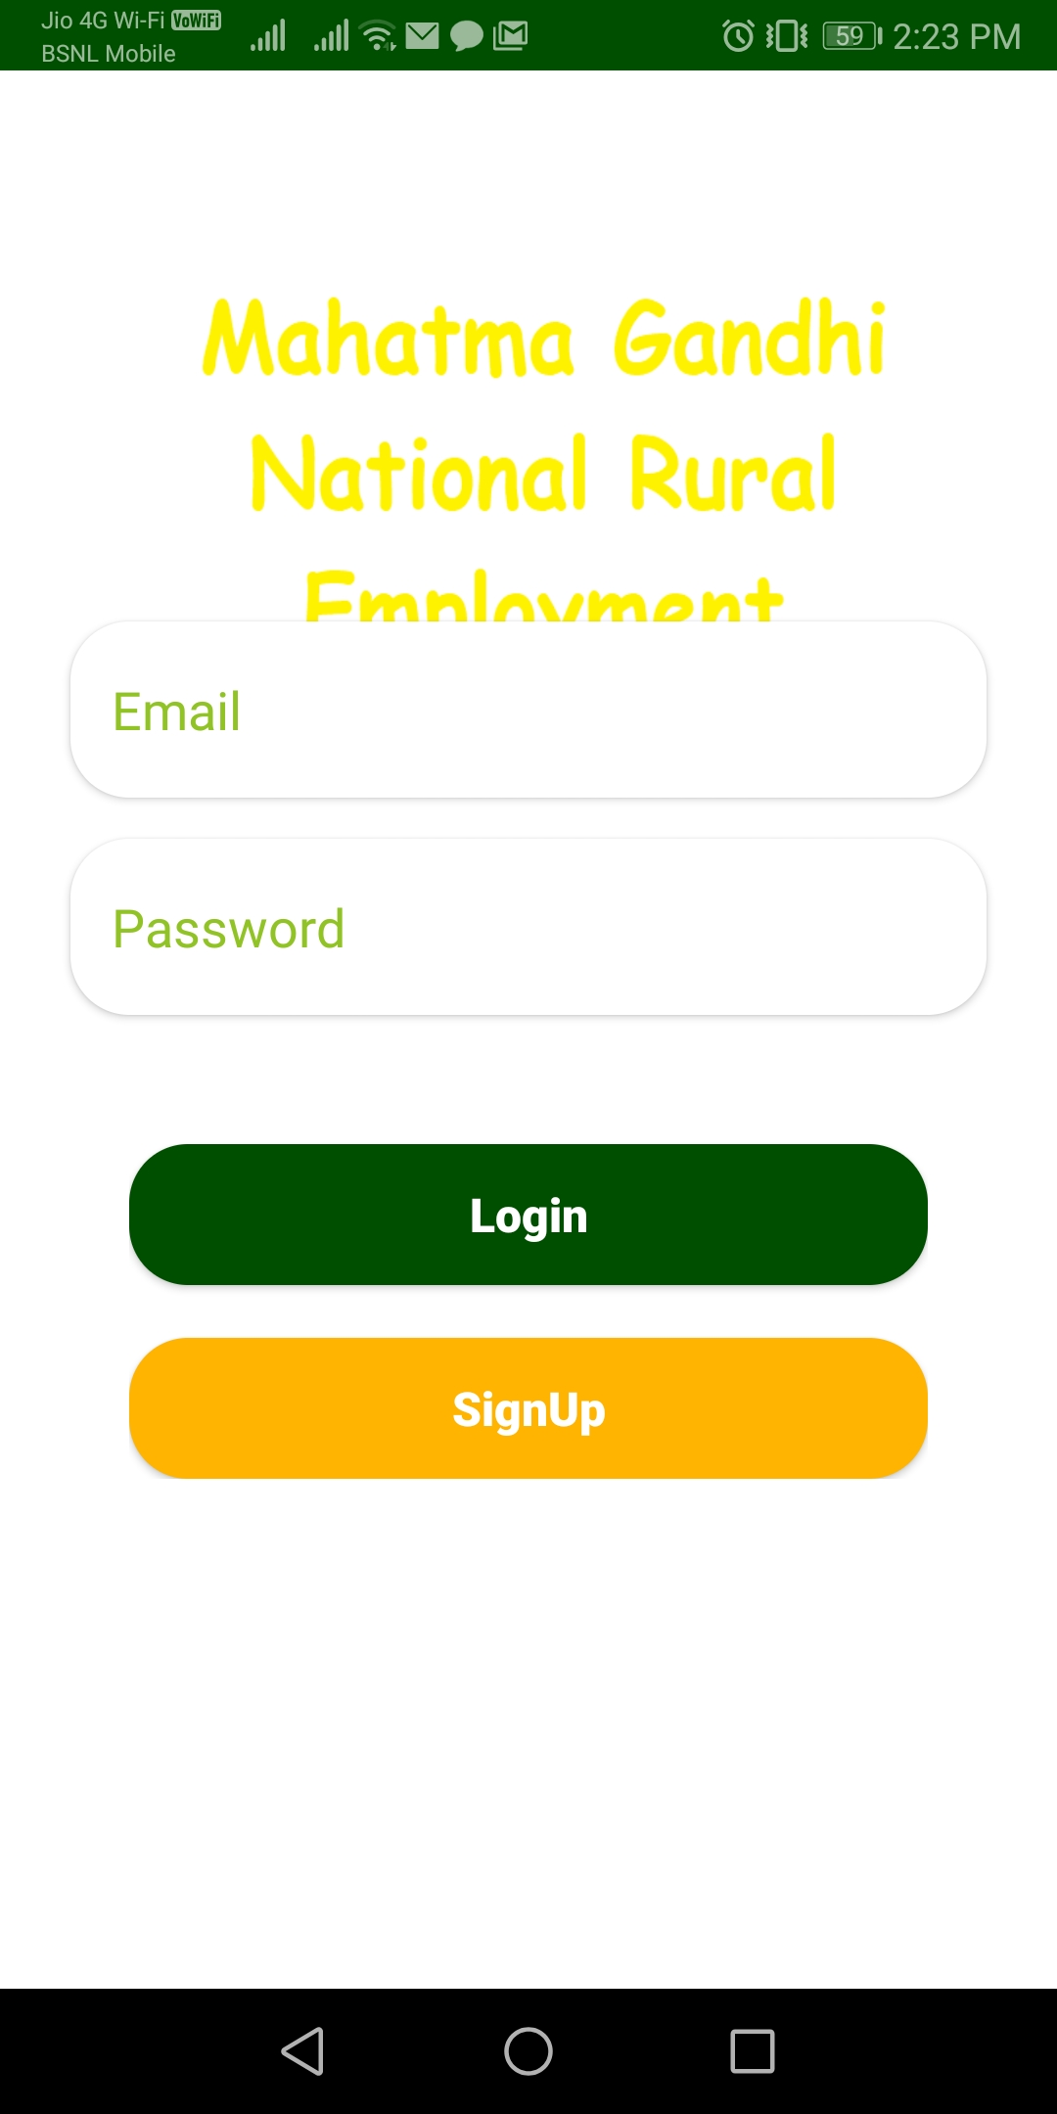
LOGIN PAGE

Slide 14
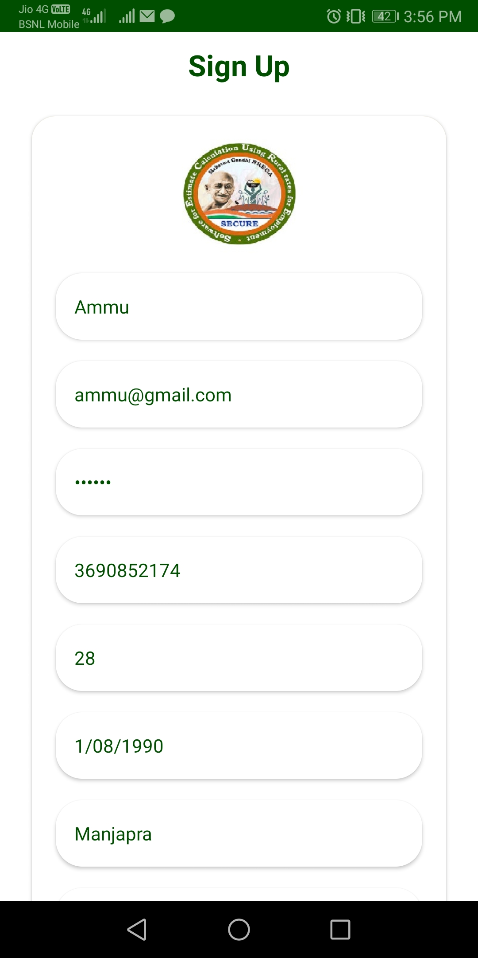
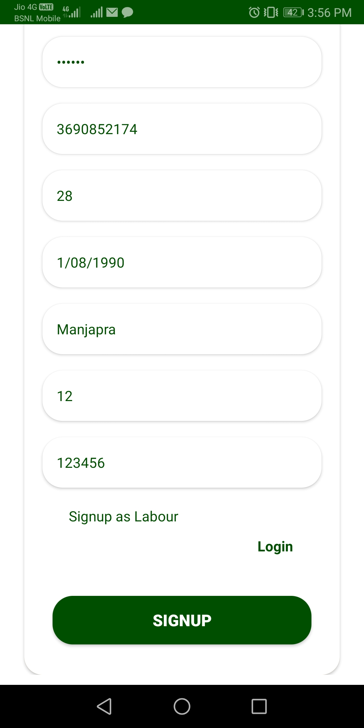
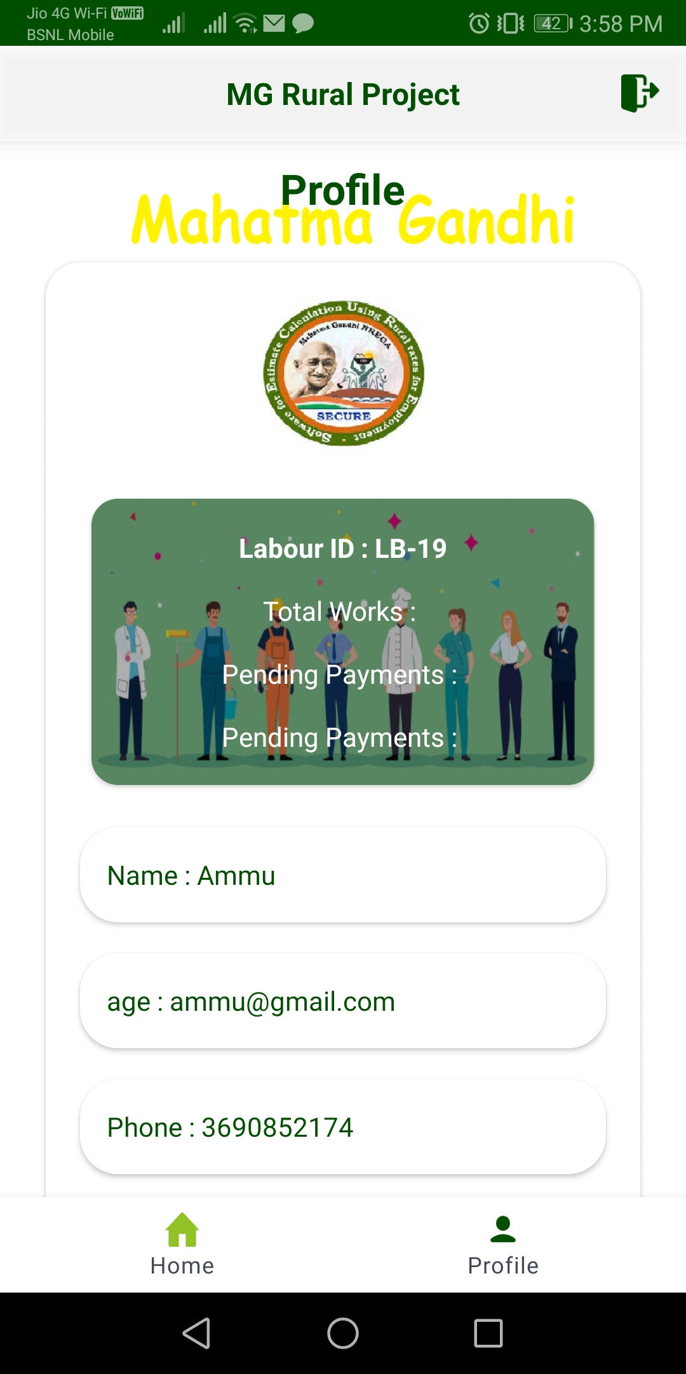
REGISTRATION LABOUR

Slide 15
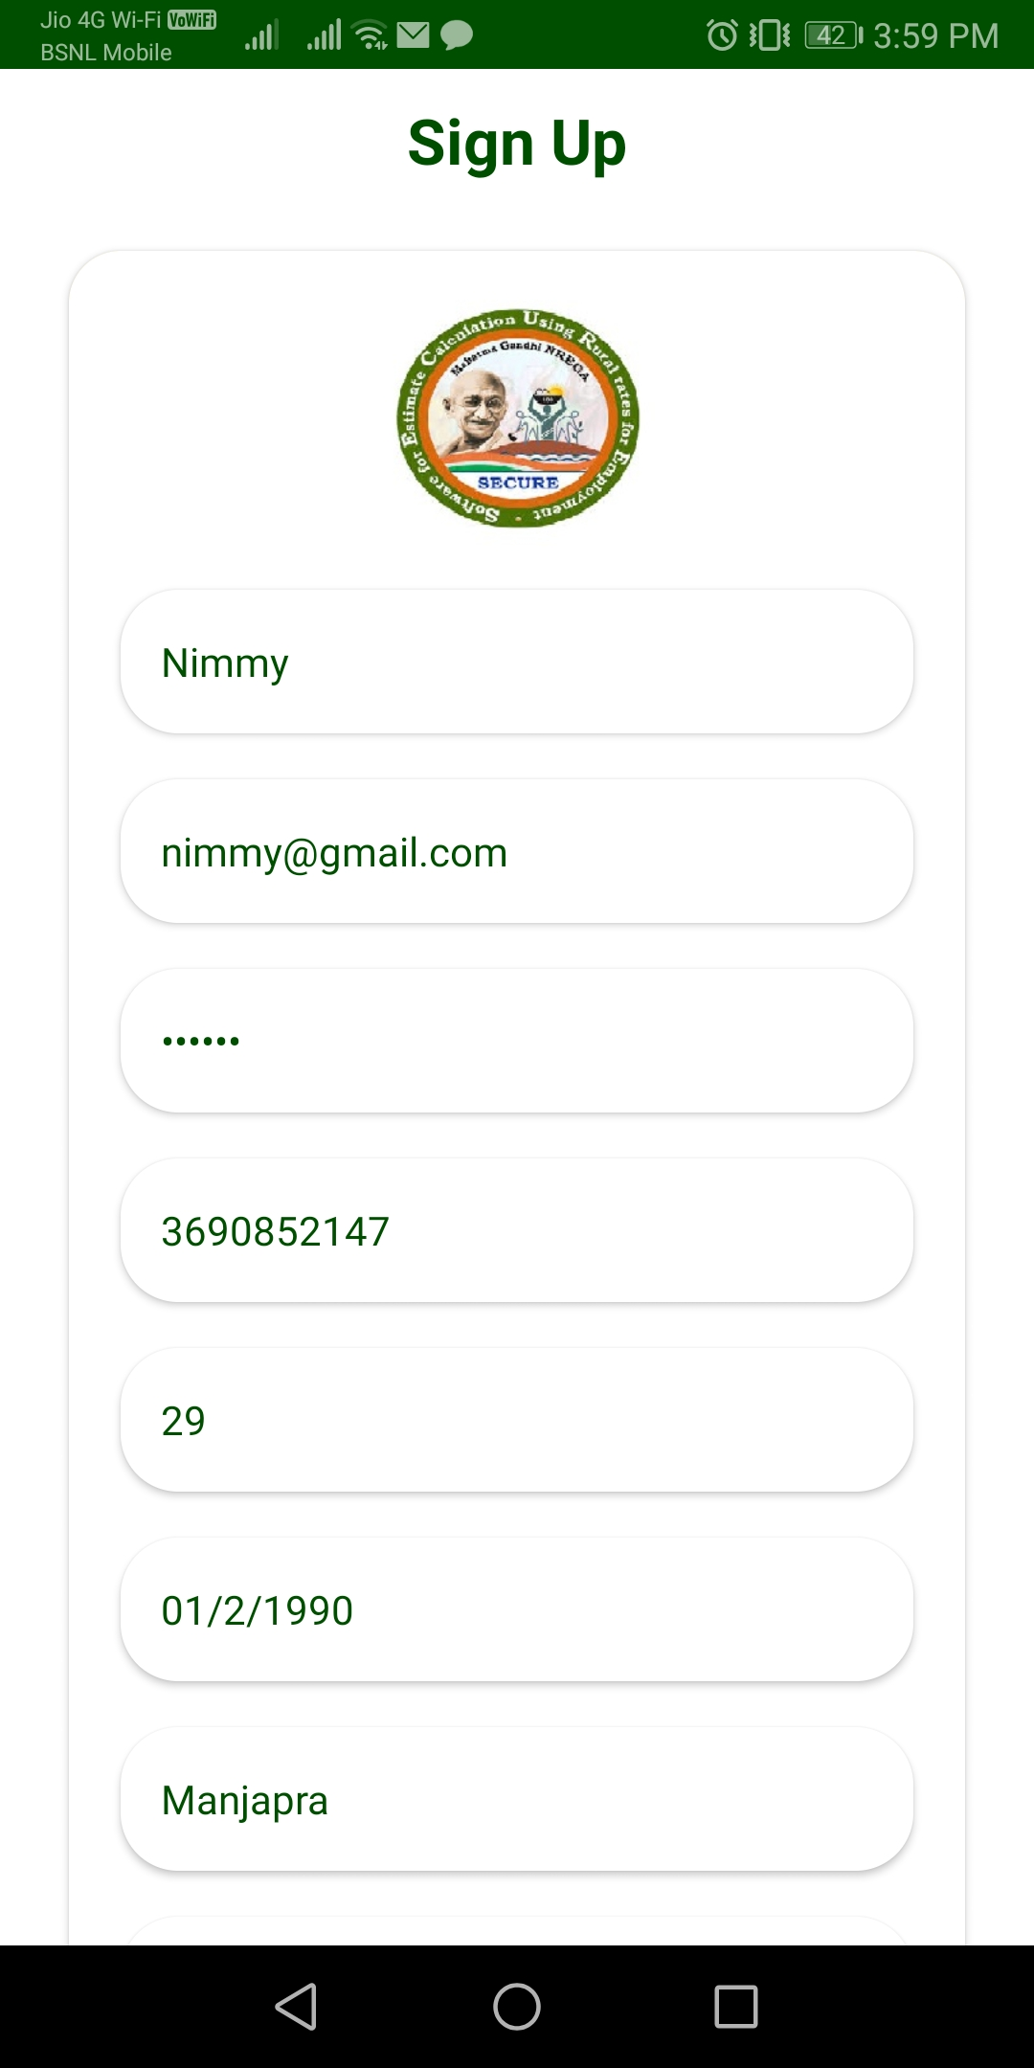
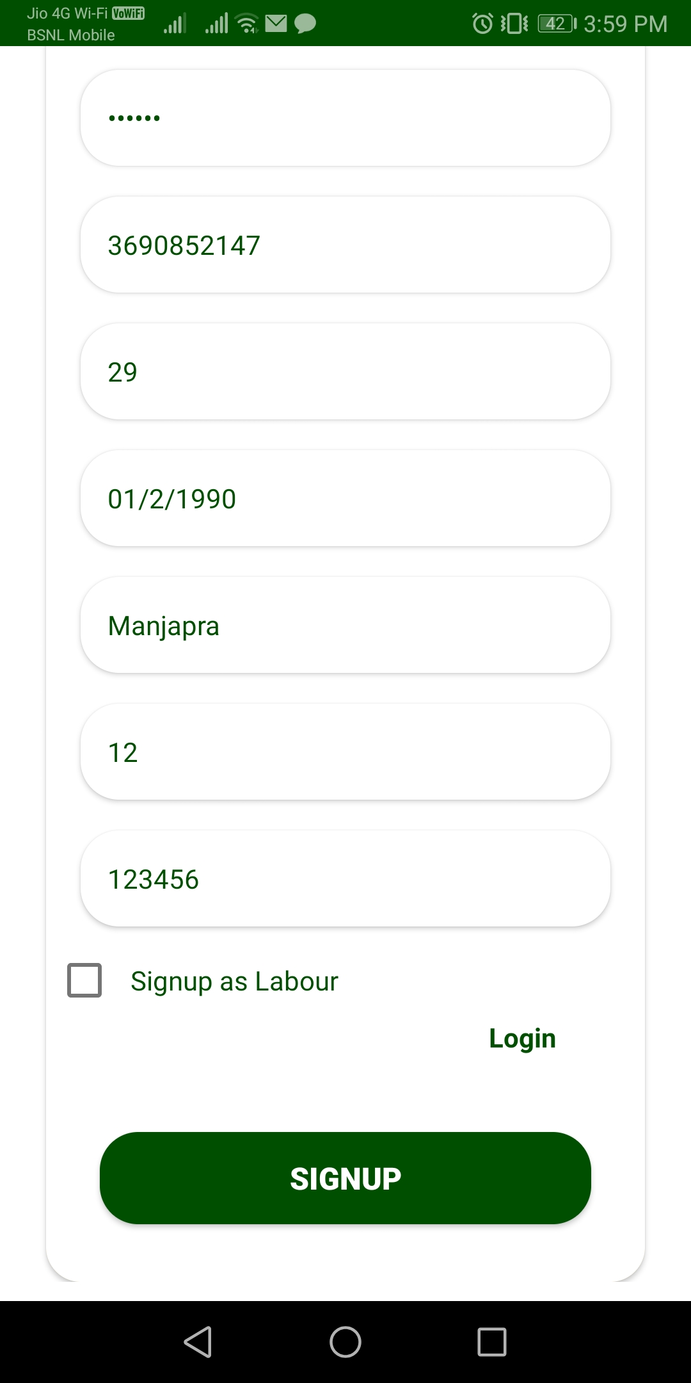
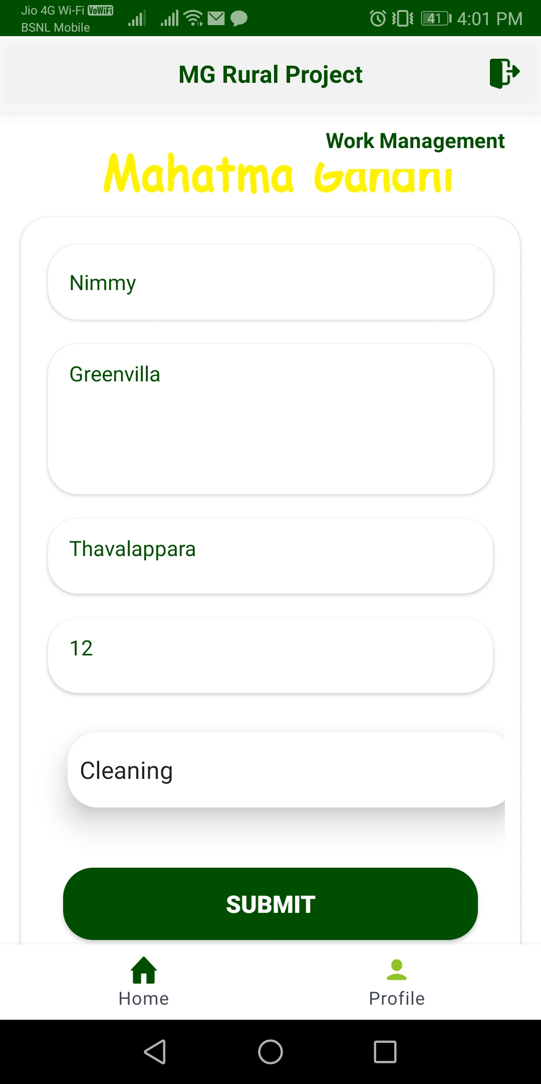
REGISTRATION USER

Slide 16
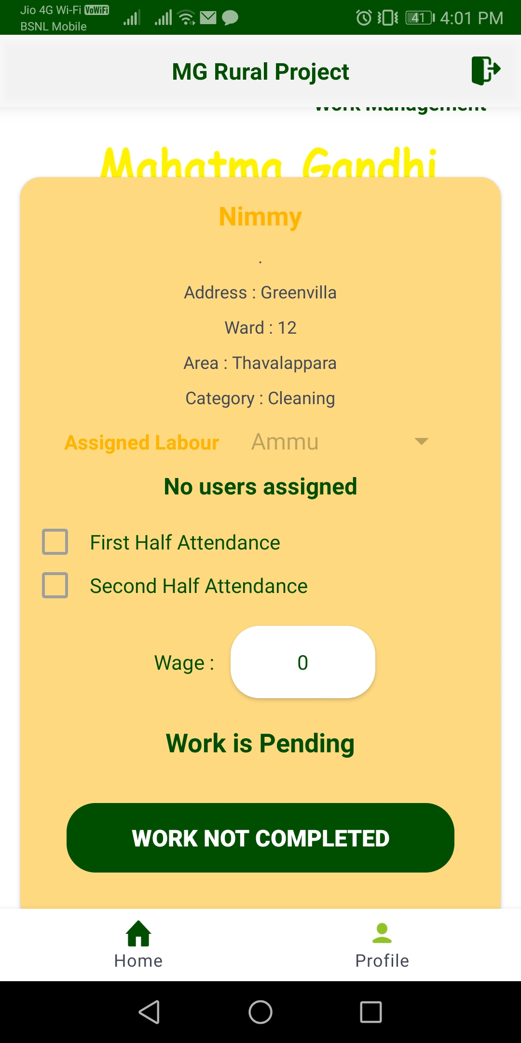
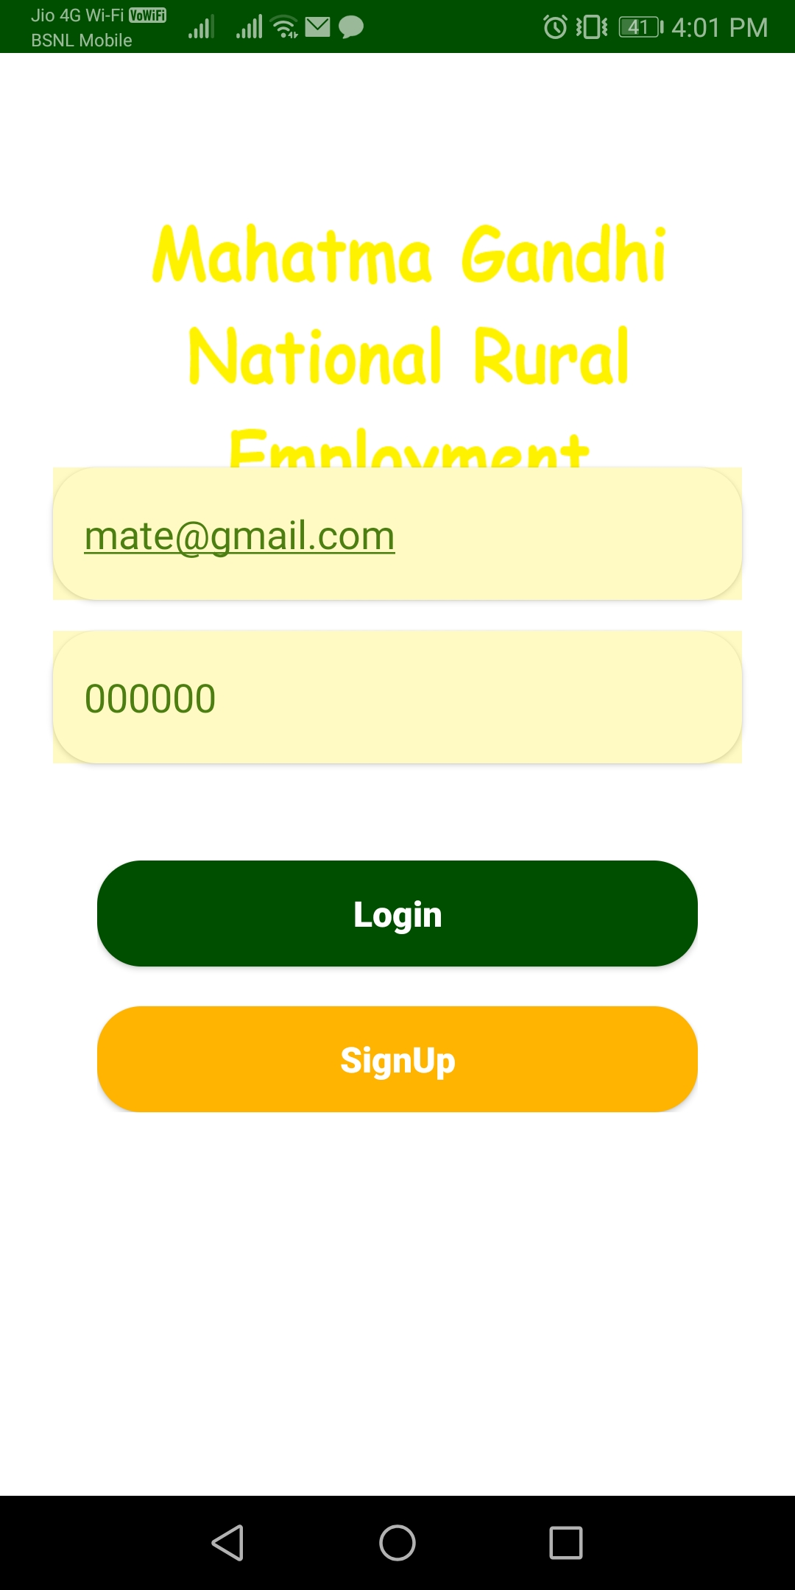
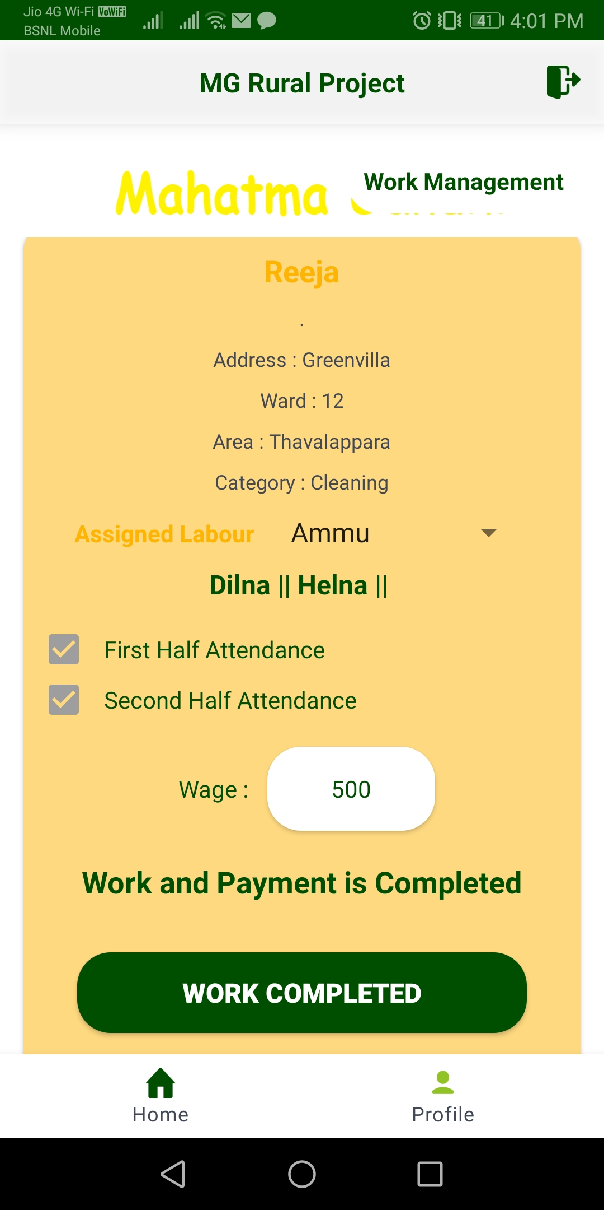

Slide 17
Thank you

